Slide 1
AUST
UNIVERSITY

Slide 2
AUST
NAME: Waqas Ahmed
Subject: DSA
Project: URL Shorter
Submitted To: Mr. Jamal Abdul Ahad
Class: 3rd BScs
Roll no: 14832
Link GitHub: https://github.com/waaqas969/URL-Shortner.git

Slide 3
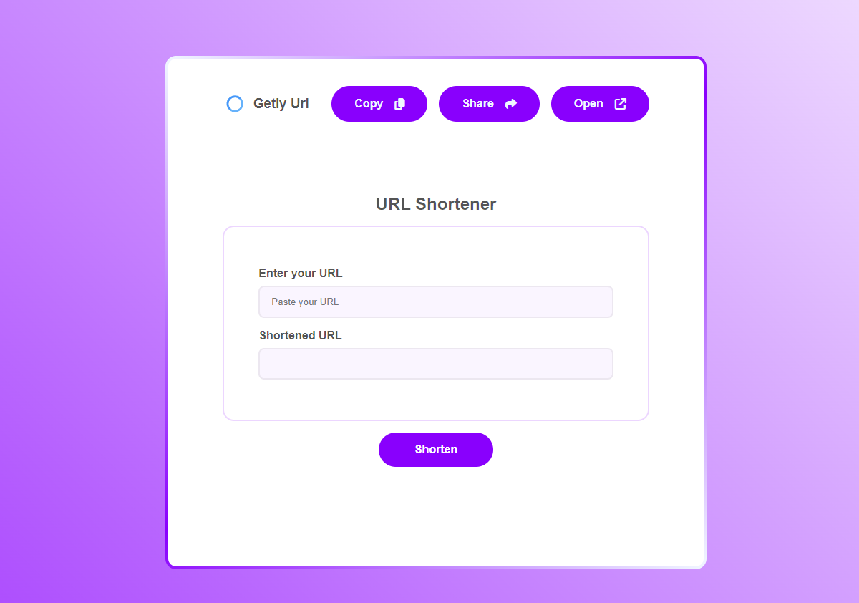
overview of Project
This project is a straightforward URL shortener created with Flask for the backend and HTML/CSS for the frontend. Users can enter a URL, which is then shortened using an MD5 hash and saved in a dictionary. The shortened URL is shown to the user, who can copy, share, or open it. The Flask app takes care of redirecting from the shortened URL back to the original. JavaScript is used to manage user interactions such as shortening, copying, and sharing.

Slide 4
flowchart of the project
START
input URL
Flask Server:
The server receives the URL
and also check URL
condition
Return Shortened URL
END
Generate Shortened URL
Redirection

Slide 5
UI Design
Our Academic Areas

Slide 6

Introduction of project
picture
Purpose: To build a URL shortener application that converts long URLs into shorter, manageable links.
Features:
Generate short URLs for user-provided links.
Copy, share, or open the shortened link directly.
Redirect to the original URL using the shortened link.

Slide 7




Technologies Used
picture
Frontend
Backend:
HTML, CSS for layout and styling.
JavaScript for interactivity and API calls.
FontAwesome for icons.
LordIcon for animated icons.
Flask for handling requests and generating shortened URLs.
Python libraries : hashlib for URL hashing
Hosting:Local development server (Flask).
JS

Slide 8
Frontend Details
picture
HTML Structure
Organized into sections for navigation, input form, and actions.
Input fields for the original URL and generated short URL.
CSS Highlights
Responsive design using media queries.
Gradient backgrounds and modern button styles.
Flexible layouts using flexbox
JavaScript Functionalities:
Shorten Button:
Sends POST request to the backend with the URL.
Displays the shortened URL in the input field.
Copy Button :Copies the shortened URL to the clipboard.
Alerts the user upon successful copy
Share Button:
Use the navigator. shareAPI for easy sharing
Open Button :
Opens the shortened URL in a new tab
JS

Slide 9
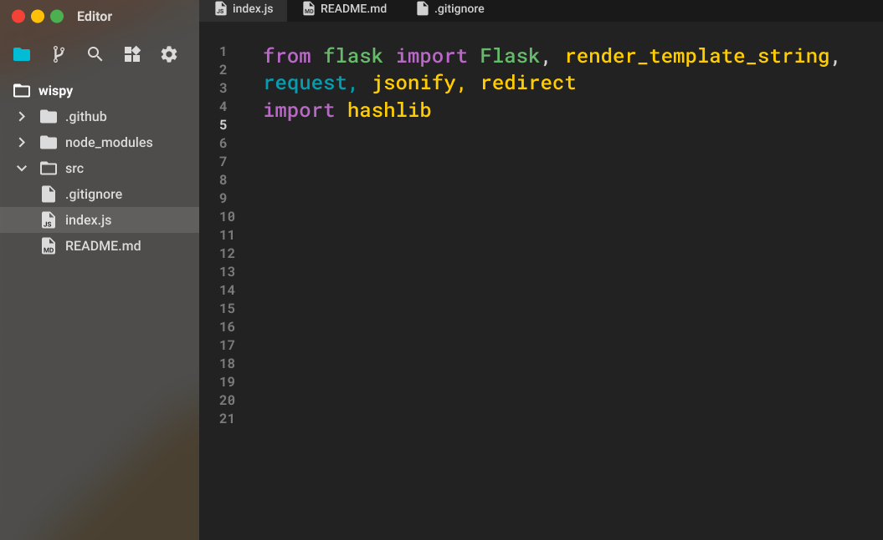
Backend Implementation of project
picture
Step:1
Flask: A basic library for developing web applications.
render_template_string: Renders an HTML template directly from a string, used for front-end.
Query: Retrieves incoming data (such as a URL) from the user.
jsonify: Converts Python data structures (such as dictionaries) to JSON format, which will be used to return data to the client side.
redirect: Redirects the user to the specified URL.
hashlib: Used to create a unique hash for the original URL..

Slide 10
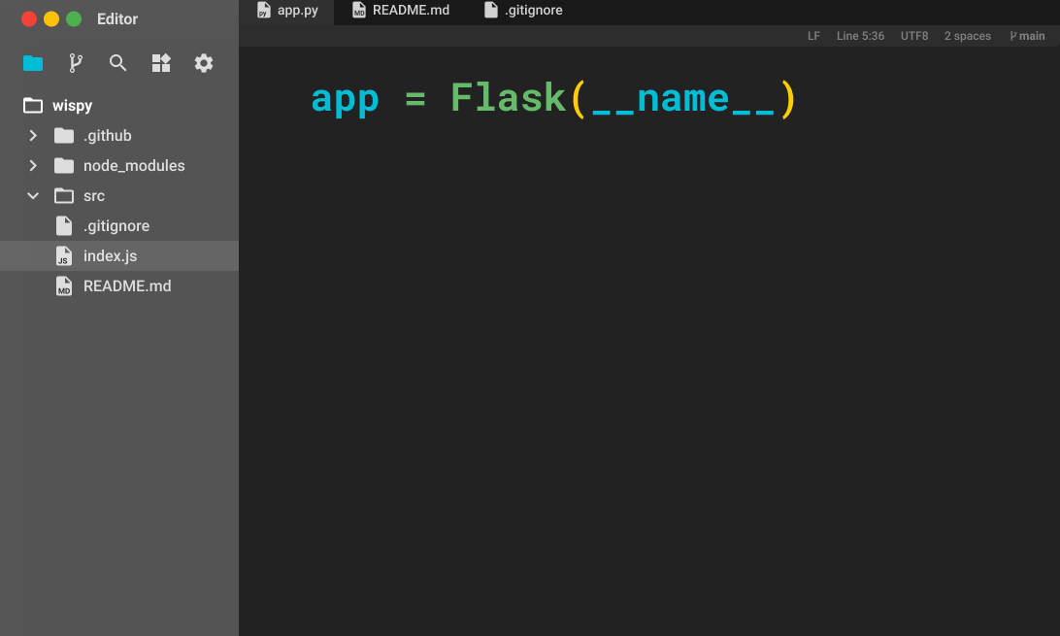
Steps of project
picture
Step:2
Setting Up Flask Application:
This line initializes the Flask application

Slide 11
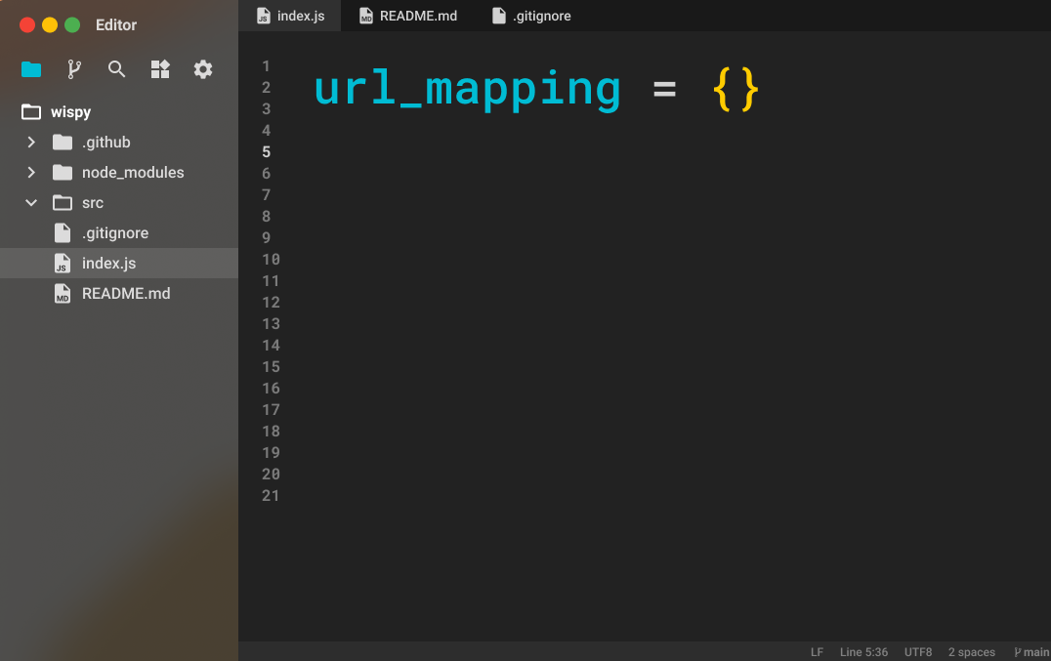
Steps of project
picture
Step:3
Global Variable to Store URL Mappings:
This dictionary will map the original URL to the corresponding short code.

Slide 12
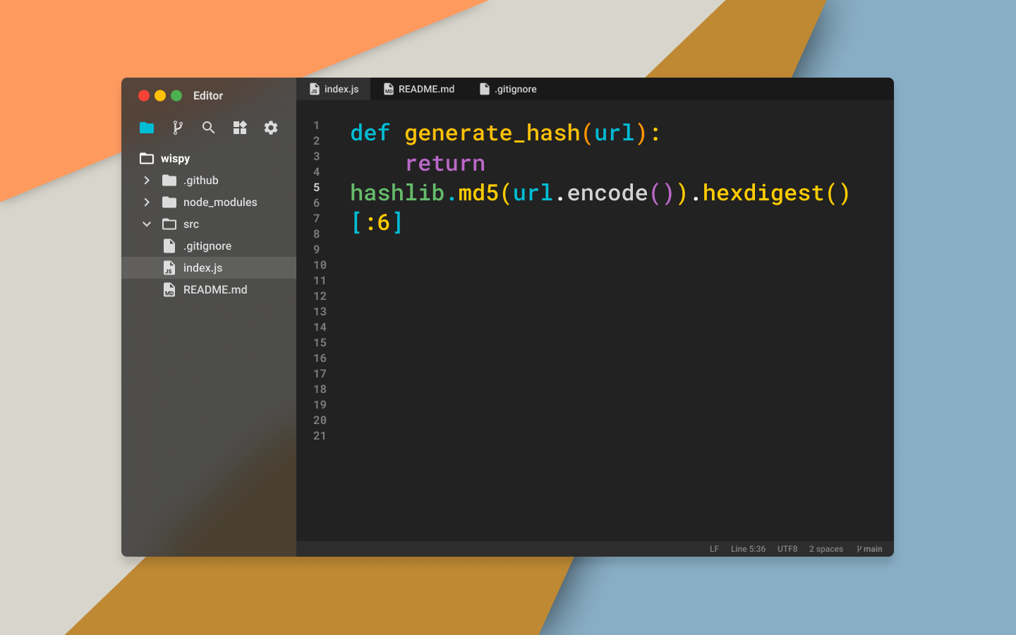
Steps of project
picture
Step:4
Function to Generate Hashes for URLs:
Creates an MD5 hash for the input URL
Returns the first 6 characters of the hash, making it a short, unique identifier for the URL.

Slide 13
Steps of project
picture
Step:5
HTML and CSS Template for the Front-End:
The HTML_template variable holds the HTML and CSS needed for the user interface. It includes:
The HTML_template variable holds the HTML and CSS needed for the user interface. It includes:
An input field to paste the original URL
A disabled input field to display the shortened URL
Buttons for shortening, copying, sharing, and opening the shortened UR

Slide 14

Steps of project
picture
Step:6
Index Route:
When a user visits the root {/} this route renders the HTML template, displaying the input fields and buttons.

Slide 15
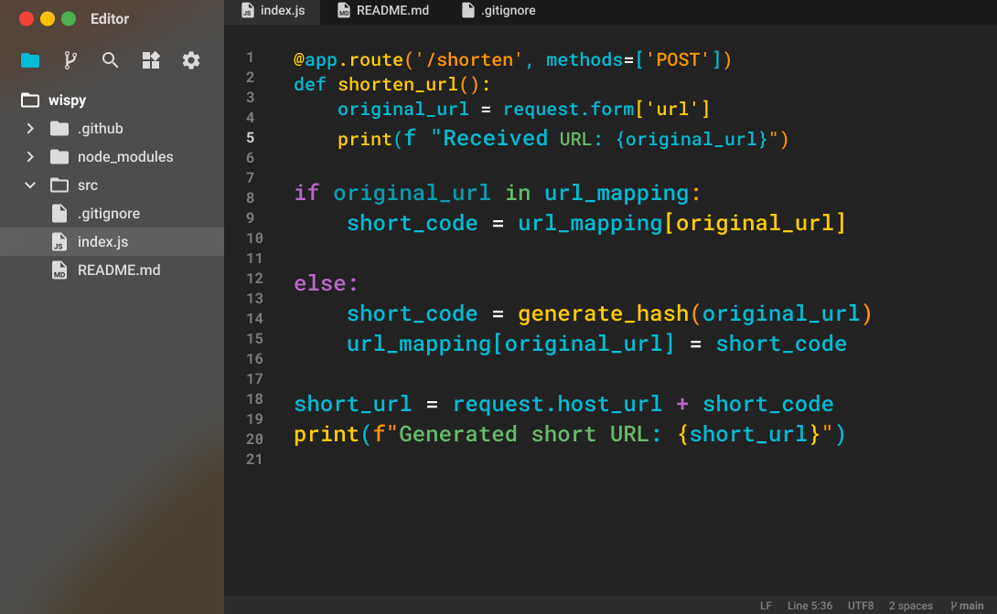
Steps of project
picture
Step:7
This route listens for POST requests on / shorten
request. Form['url']
.If the original URL is already shortened, it retrieves the short code from the
url_mapping dictionary.
If the URL hasn’t been shortened before, it generates a new short code using the
generate hash function and stores the mapping in url_mapping
The short URL is created by appending the short code to the base URL (host URL of the server).
This short URL is then returned as JSON to the client.

Slide 16
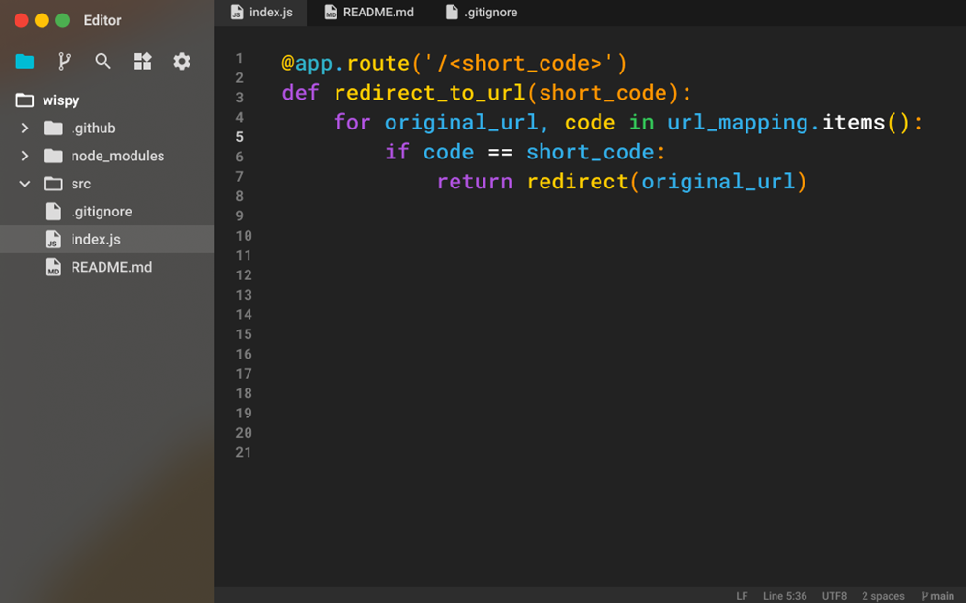
Steps of project
picture
Step:8
Redirection to Original URL:
This route captures the short code from the URL.
It looks up the short code in the url_mapping dictionary and redirects the user to the
corresponding original URL.

Slide 17
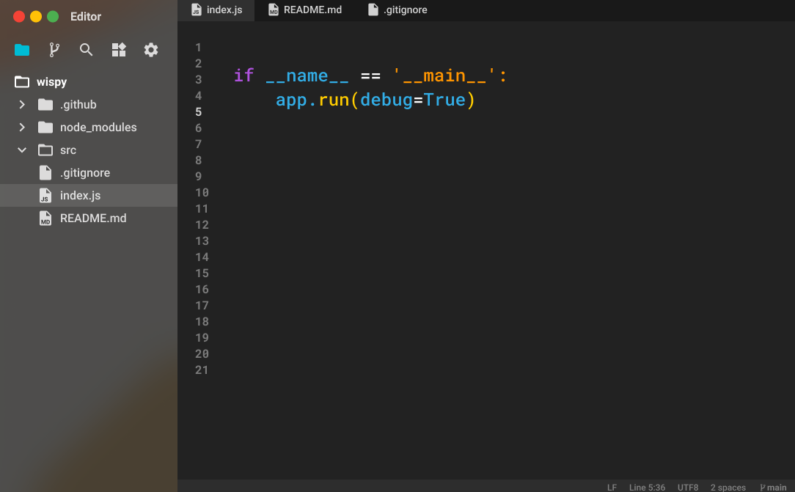
Steps of project
picture
Step:9
Running the Application:
This starts the Flask development server in debug mode.

Slide 18
AUST
THANK YOU
I hope you like my presentation
Next time I will do better

